Slide 1

Conduct a market analysis
Presented by: Octave Antoni
Last Updated: July 12th, 2022

Slide 2
Table of contents
Introduction
Dataset
Key findings
Analysis of Gaussian variables
Conclusion

Slide 3
Introduction
Theme of the project : Conduct a market analysis in the food sector
Company : Agribusiness which specializes in chicken
Products will be exported to candidate countries and not produced locally
Main objective ➔ Target specific countries for the company to expand internationally
Analysis of each country’s diet, population and other factors to find best candidates
Cluster analysis ➔ Find the best group of countries that could be targeted

Slide 4
Dataset

Slide 5
Dataset
Freely available on https://www.fao.org/faostat/en/#data
Many different categories ➔ mainly used : food balance, trade (chicken import value) and macro economic indicators (GDP)
Very flexible ways of downloading data, selecting only relevant years / items
Food balance data complete, some missing chicken imports / GDP Data
Year of data : 2019 (most recent food balance data)
Probably for political reasons, China data duplicated

Slide 6
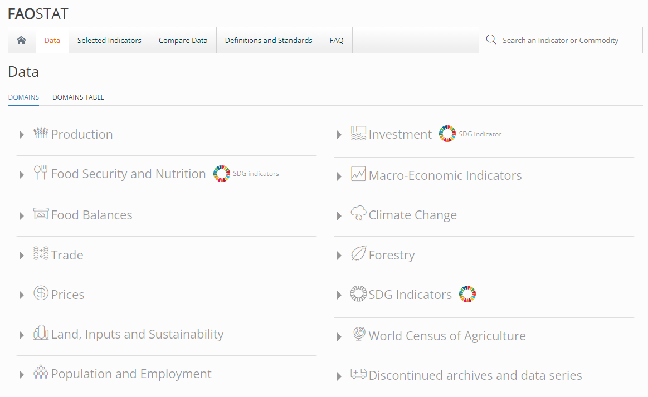
FAO Dataset
https://www.fao.org/faostat/en/#data
GDP
Food/Protein Supply
Population
Value of Chicken Imports

Slide 7
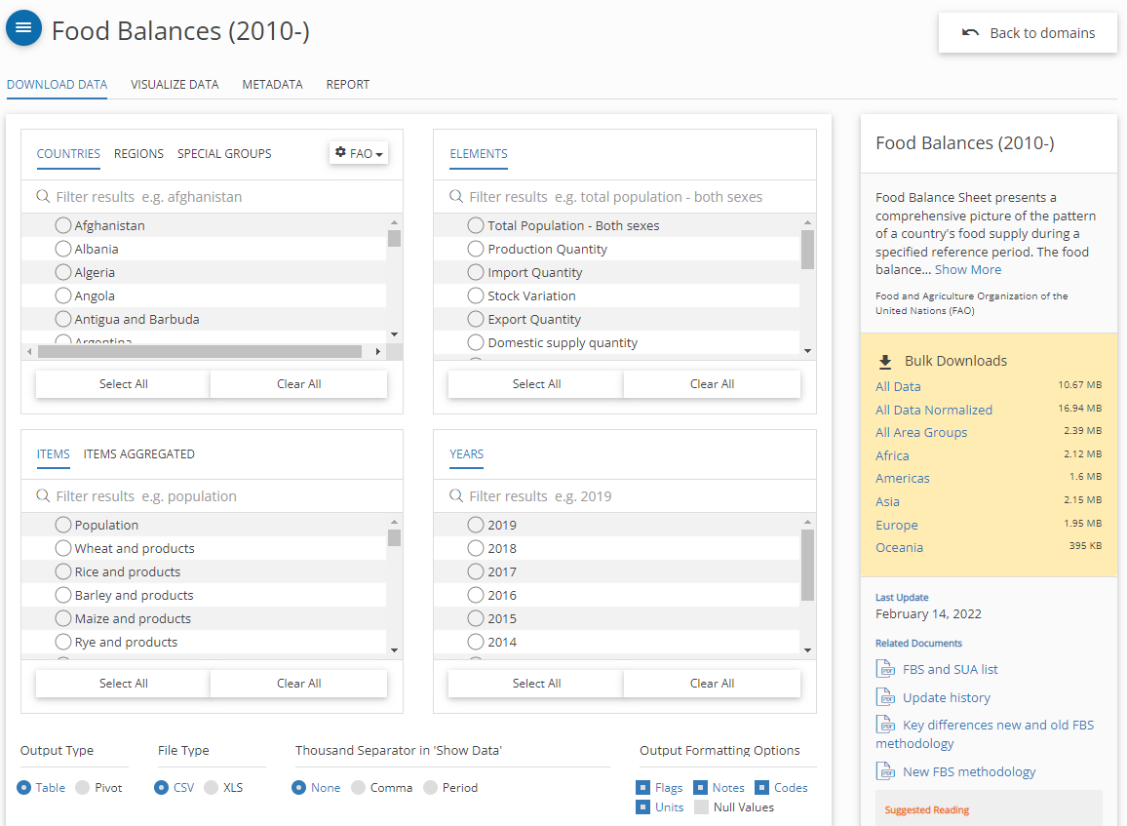
FAO Dataset
https://www.fao.org/faostat/en/#data/FBS

Slide 8
Data Aggregation and cleaning
Removed duplicated data from China (identical to the work done in Project 4)
Removed columns that do not provide a lot of information
Renamed columns to make them easily selectable
Pivoting the data so we end up with one row per country (year 2019)
Aggregating all the necessary data into a single dataframe with all the relevant information

Slide 9
Key findings

Slide 10
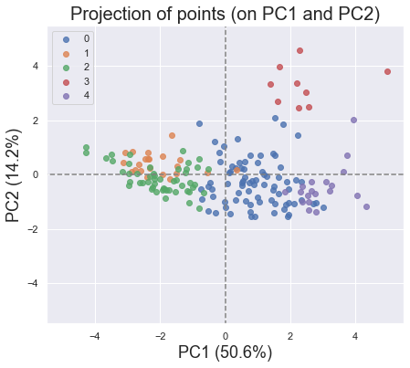
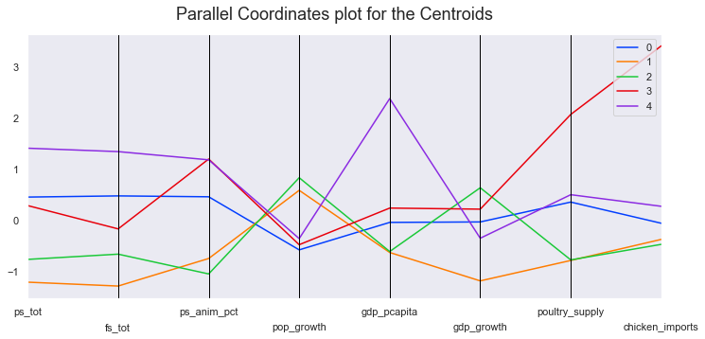
Pinpointing candidate countries
179 countries studied with hierarchical clustering
All data calculated (except growth) studied on a per capita basis
Variables selected :
ps_tot / fs_tot : Protein and Food supply in g/kcal capita day
ps_anim_pct : Percentage of protein supply from animal food
pop/gdp_growth : Population / GDP annual growth
gdp_pcapita : GDP per capita (USD/capita)
poultry_supply : Supply / capita of poultry
chicken_imports : Per capita value of chicken imports (USD/capita)

Slide 11
Hierarchical clustering model explained
Number of clusters defined as 5 IAW manager’s directives
Dendrogram shows that 6 (distance = 10) was probably a better number of clusters
Link to the dendogram
8 variables have been selected
Conclusions are identical ➔ The selected cluster has a low overall distance

Slide 12
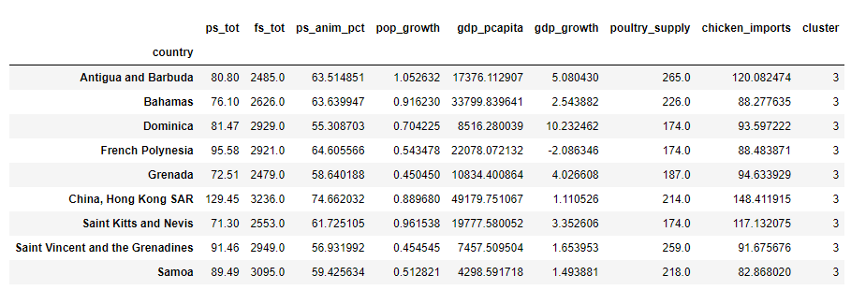
Selecting the best cluster
Hypothesis: we will select high GDP countries with a high percentage of protein from animal food and high value of chicken imports
First cluster identified : cluster 3, very high value of chicken imports per capita
Problem : composed of small insular countries
Selected cluster : cluster 4, high gdp per capita and second highest chicken imports, high ps_anim_pct
Cluster 3
countries

Slide 13
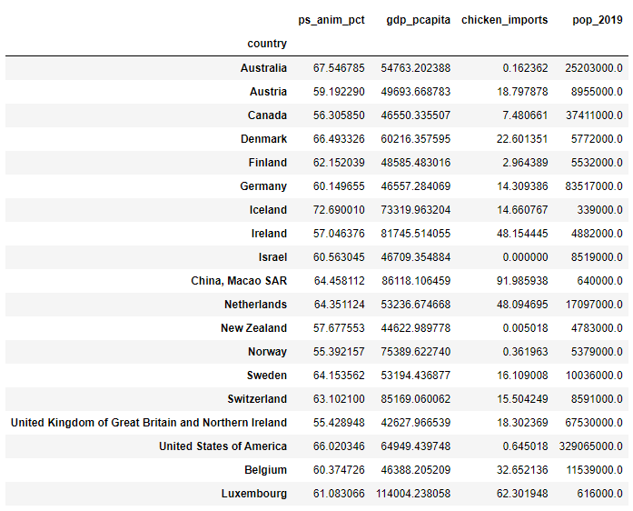
Selecting candidate countries
Analysis of cluster 4 : Some countries have very low populations (< 1 million) ➔ too small markets
Other countries have very low chicken_imports value per capita ➔ not interesting for our company
The remaining 9 countries are our selected candidates :
Austria | Denmark
Germany | Ireland
Netherlands | Sweden
Switzerland | UK & Northern Ireland
Belgium

Slide 14
Analysis of Gaussian variables

Slide 15
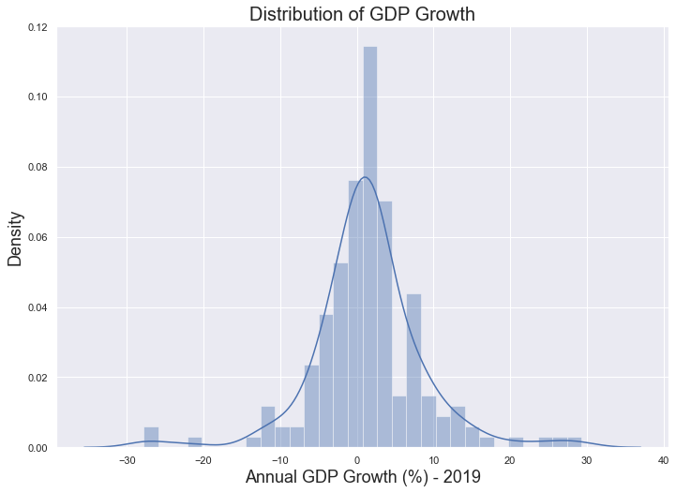
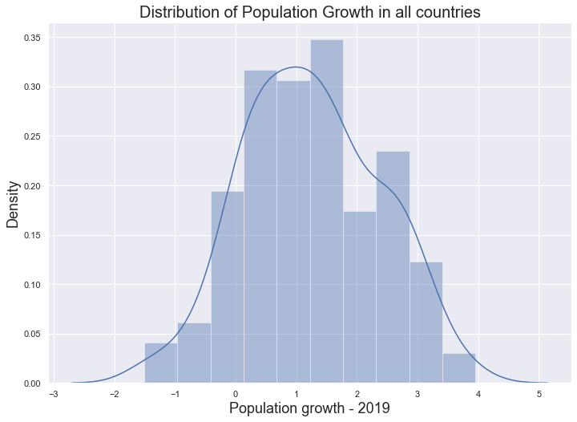
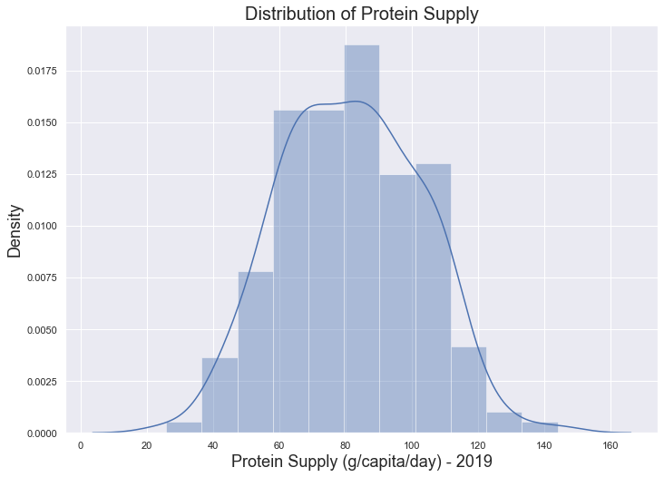
Testing potential Gaussian variables
Not normally
distributed
Analysis of the distribution of all variables with sns.distplot
Visual selection of 3 potential normally distributed variables
Normalization of the variables
Test of variable distribution using the Kolmogorov Smirnoff test (null hypothesis = normally distributed)
GDP Growth : KS_p = 0.006
Population Growth : KS_p = 0.783
Protein Supply : KS_p = 0.736
Normally
distributed
Normally
distributed

Slide 16
Comparing our clusters
Since we have 2 normally distributed variables, we can perform ANOVA ➔ compare our clusters
First, we perform ANOVA on all clusters using a “Variable ~ C(cluster)” OLS model
Eta² pop_growth : 0,41 – Large effect size
Eta² ps_tot : 0,65 – Larger effect size

Slide 17
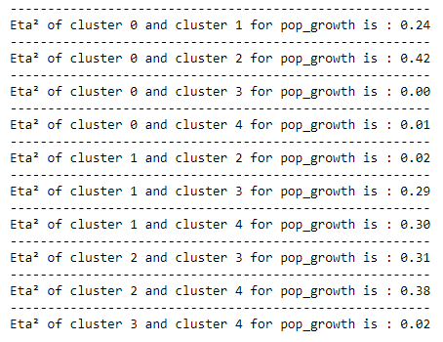
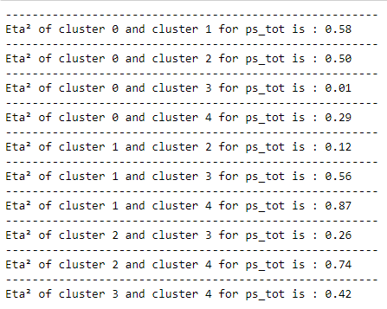
Comparing cluster pairs
Building a script to perform ANOVA on each cluster pair for both variables
Population growth : strongest meaningful difference is between, clusters 0 and 2 (eta² 0.42)
Protein supply : Very large effect size between clusters 1 and 4 (eta² = 0.87)

Slide 18
Recommendations

Slide 19
Recommendations
Focus on the 9 targeted countries to expand the business
Add distance and/or shipping cost as a variable in our algorithm
Number of site visitors could also be used as an additional variable
Start expanding by selecting countries with low distance and/or shipping cost from the list
Refine the model once the profitability of some countries has been assessed empirically
To expand further, remove the selected countries and rerun the algorithm with refined metrics

Slide 20
Questions?

